Slide 1
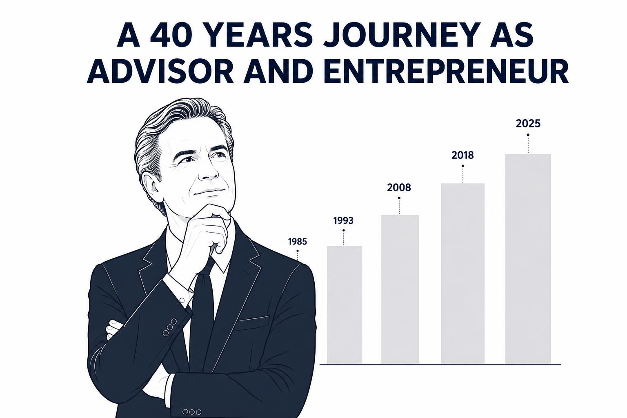
APPENDIX
The Cooach Story
The 40-Year Quest to Build the Operating System for Entrepreneurs

Slide 2

CHAPTER 1
The First Ledger
1985
"My first ERP system was a pencil."
Before cloud software. Before spreadsheets.
Helping his father's business with bookkeeping taught Carl-Fredrik something fundamental: every business is ultimately a flow of information. If the information is wrong, every decision becomes wrong.
LESSON Data matters.
Cooach — The 40-Year Story

Slide 3

CHAPTER 2
Learning the Language of Business
1988 – 1993
A young auditor carrying binders through the offices of PwC. University studies, military service, a stint in Germany.
Carl-Fredrik discovered accounting was more than compliance — it was the operating system of a company. Every successful company had structure. Every failing company had warning signs hidden in the numbers.
LESSON Good decisions require good information.
Cooach — The 40-Year Story

Slide 4
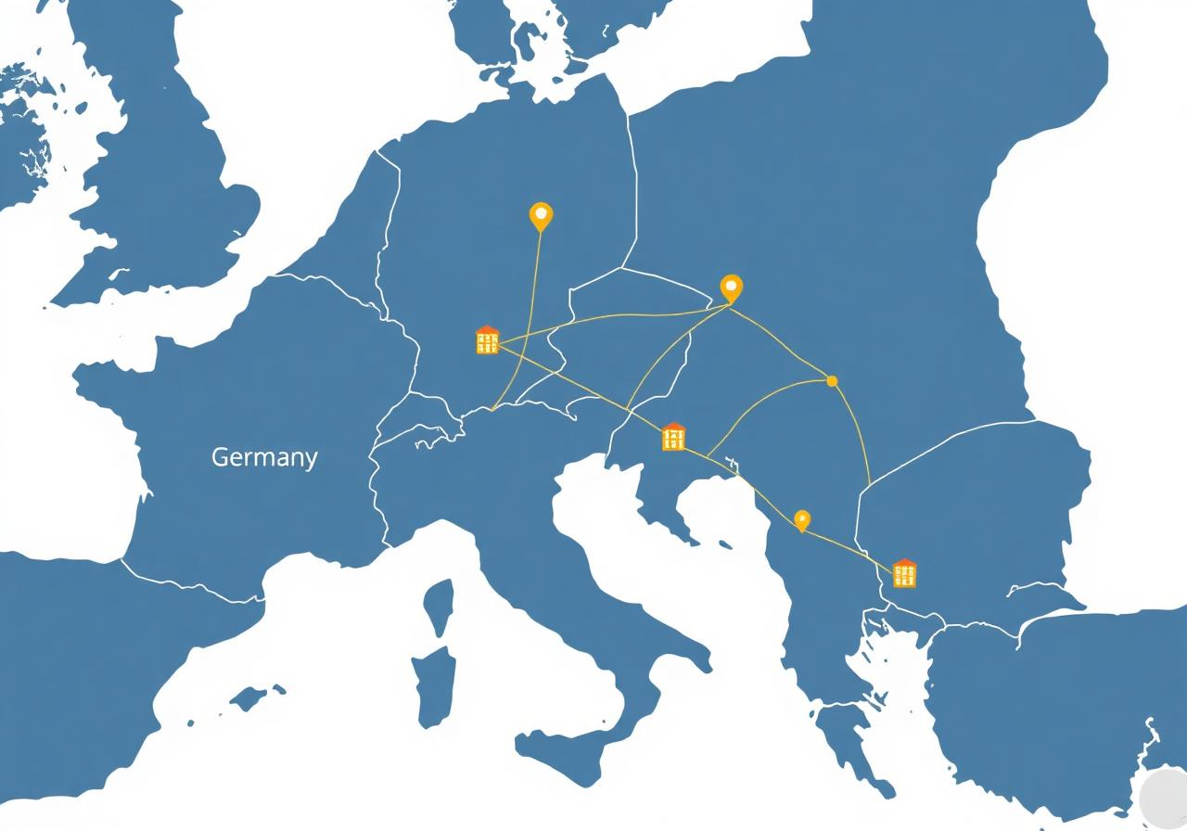
CHAPTER 3
The Entrepreneurial Auditor
1993 – 2006
Instead of following a traditional corporate path, Carl-Fredrik built offices, entered new countries — Germany, Estonia, Latvia, Lithuania, Sweden — and became a partner.
For the first time he experienced entrepreneurship from the inside. Not as an auditor. As a builder.
LESSON Entrepreneurs need more than reports. They need support.
Cooach — The 40-Year Story

Slide 5
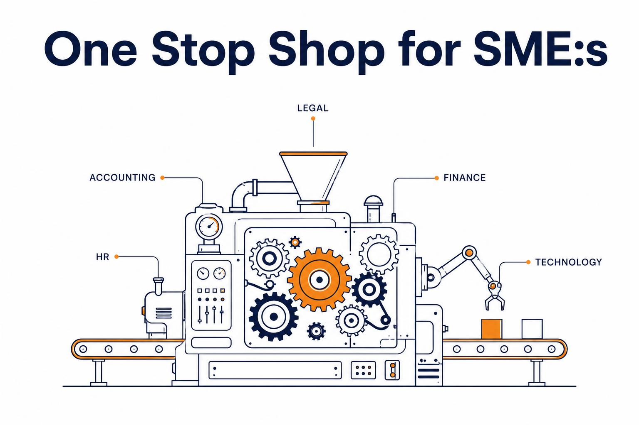
CHAPTER 4
The First Big Vision — Moretime
2008 – 2016
A giant machine labelled "One Stop Shop for SMEs". Accounting, HR, Legal, Financing, Technology — all under one roof.
The vision was simple: give small companies access to the same support structure as large enterprises. The problem? The technology did not exist yet. Cloud software was immature. Slack had not launched. AI was science fiction.
LESSON The vision was right. The timing was wrong.
Cooach — The 40-Year Story

Slide 6
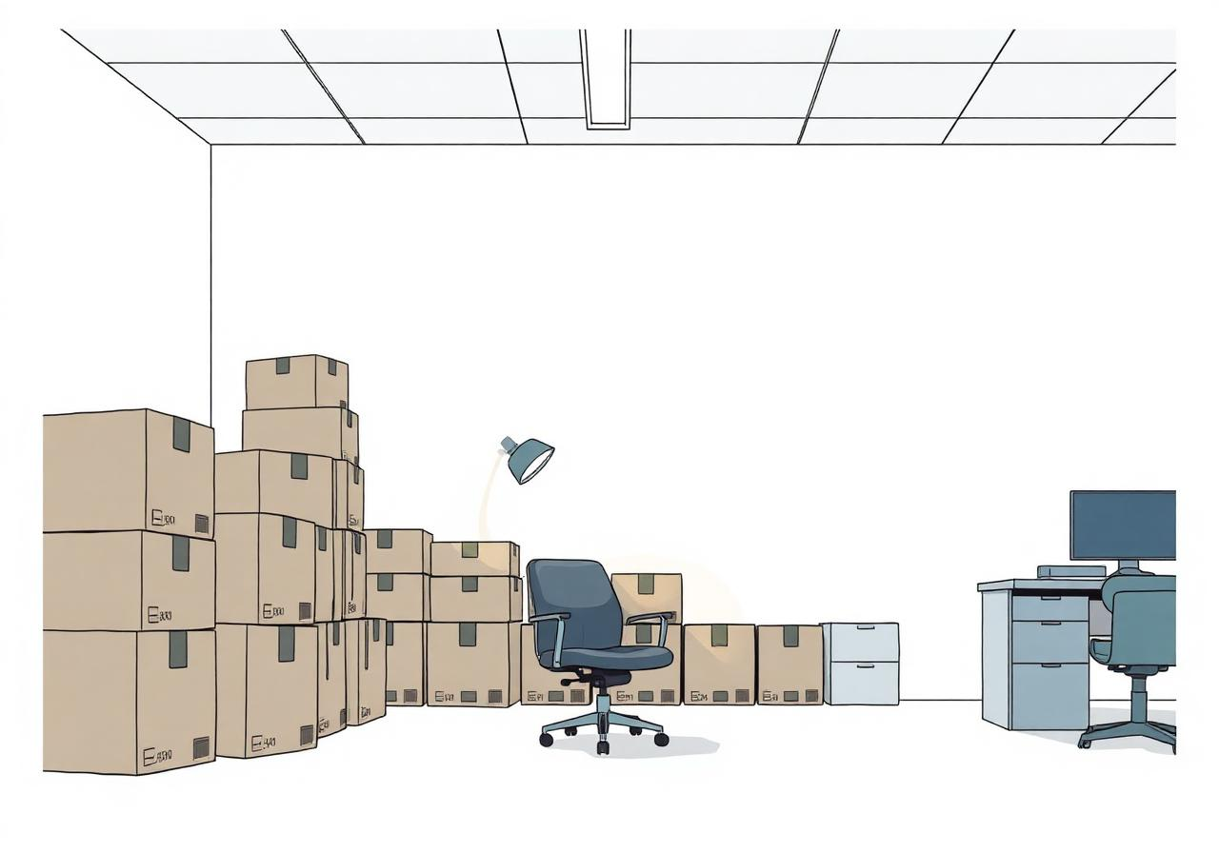
CHAPTER 5
Failure
Boxes being packed. Office lights turned off.
The platform never reached its full potential. The business was restructured. Many parts survived. The platform did not.
LESSON Building software is harder than building companies.
Cooach — The 40-Year Story

Slide 7

CHAPTER 6
Spain
2018
After Moretime, the objective changed. Smaller. Simpler. More human.
Carl-Fredrik arrived in Marbella with a laptop. Cooach was born. The idea: use Slack as a digital headquarters and connect entrepreneurs with experts.
LESSON People value access more than ownership.
Cooach — The 40-Year Story

Slide 8

CHAPTER 7
The World Changes
2020
When the pandemic arrived, the world accidentally adopted the operating model Cooach had already built.
Remote work became normal. Digital collaboration became normal. Customers increased. The concept worked.
LESSON Sometimes the world catches up with your idea.
Cooach — The 40-Year Story

Slide 9

CHAPTER 8
The Second Attempt
2021 – 2023
With new investment and a growing customer base, Cooach tried again. Build the platform. Integrate services. Create the digital twin.
Again the vision outran the technology. The result was better than before — but still not enough.
LESSON The idea was still right. The tools were still wrong.
Cooach — The 40-Year Story

Slide 10

CHAPTER 9
Becoming Investors
2023 – 2025
A realization emerged. Cooach knew more about many growth companies than traditional investors — not because of better analytics, but because Cooach worked inside the businesses.
That led to equity investments, debt financing, the Maderna partnership, Cooach Equity and the Cooach Debt Fund.
LESSON Operational insight creates investment opportunities.
Cooach — The 40-Year Story

Slide 11
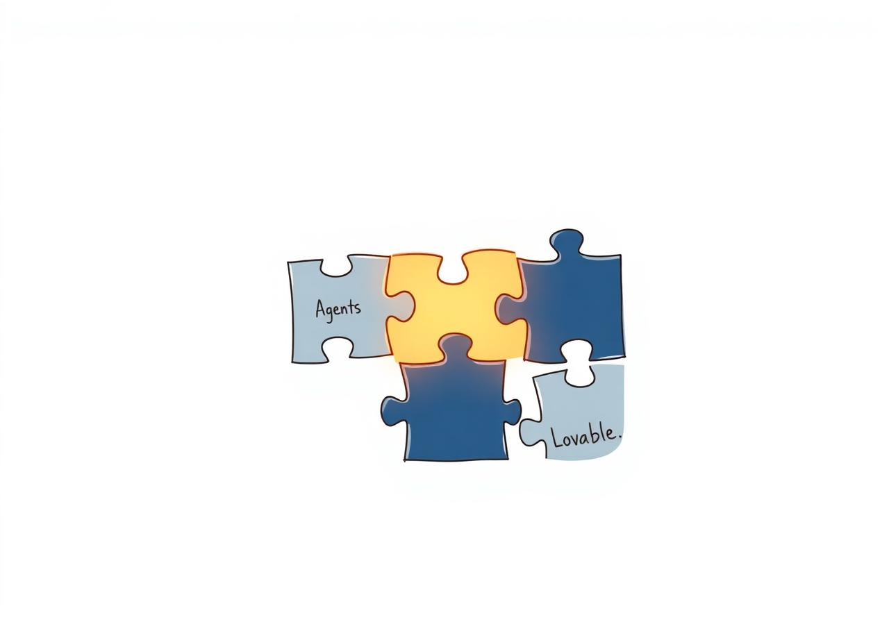
CHAPTER 10
The Missing Piece Appears
2025 – 2026
For twenty years the missing piece had been software development.
Then AI arrived. Suddenly the cost of building software collapsed. Ideas could become products in days instead of years. The development team Carl-Fredrik always wanted finally existed.
LESSON Technology finally caught up with the vision.
Cooach — The 40-Year Story

Slide 12
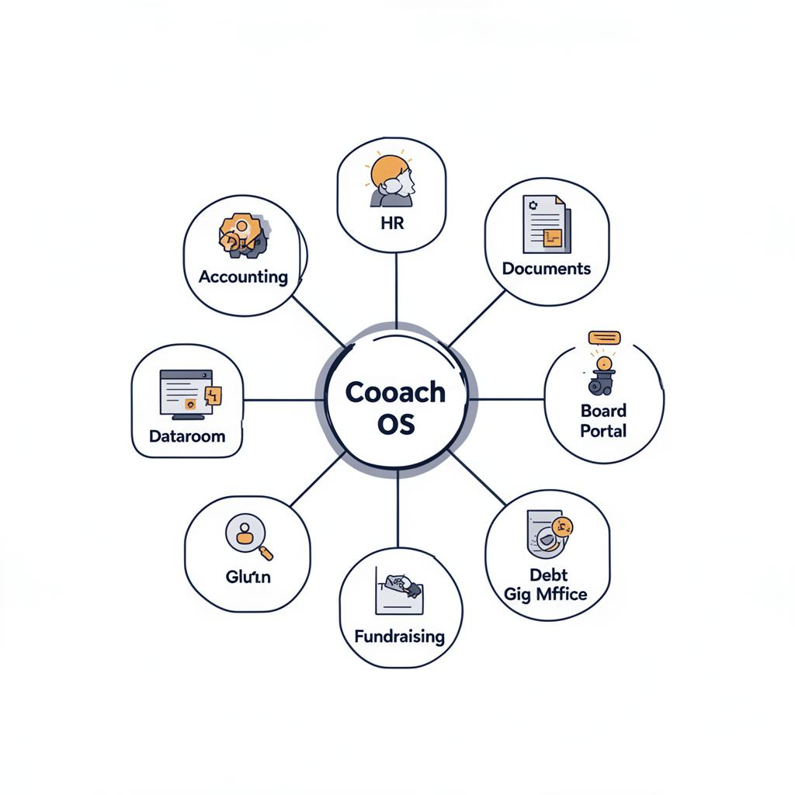
CHAPTER 11
The Cooach Operating System
Today
A complete ecosystem with Cooach OS at the center — Accounting, HR, Documents, Board Portal, Dataroom, Growth, CX, Planning, Fundraising, Debt Fund, Family Office, Gig Market, Ecosystem Rewards.
The goal is no longer to build software. The goal is to build an ecosystem where entrepreneurs get support, investors get access, experts find opportunities, AI removes friction, and humans create value.
LESSON Not a product — an ecosystem.
Cooach — The 40-Year Story

Slide 13

40 years. 70,000 hours. Three attempts.
Now the technology is finally ready.
Connecting Investors and Builders.
Cooach — The Operating System for Entrepreneurs

